Slide 1


CODE:CAF 18/12
RESEARCH PROJECT BRIEFING
Remission of Type 2 diabetes in Scotland
AIMS
The overall aim of this thesis was to explore the potential opportunities and challenges for primary care presented by remission of type 2 diabetes in Scotland. In 2018 the Scottish Government announced a £42 million pound investment to support a framework to improve weight management support for people with type 2 diabetes. There was lack of clarity about how to define remission, what the baseline level of remission in the Scottish population was and how primary care professionals (PCPs) understood remission. This thesis aims to address these issues
KEY FINDINGS
Systematic Review
There were 96 different definitions of remission of type 2 diabetes. This was based on a systematic review of 178 papers from 2009 to 2020. This makes it confusing to define remission.
Quantitative Analysis
5% of people with a diagnosis of type 2 diabetes and a previous blood sugar reading in the diabetes range (HbA1c 48 mmol/mol or above) in Scotland in 2019 were in remission of type 2 diabetes (defined as blood sugar levels below the diabetes range in the absence of glucose-lowering drugs for a continuous duration of ≥365 days).
Factors associated with remission were: older age, blood sugar reading below the diabetes range (HbA1c below 48 mmol/mol at diagnosis), no previous history of glucose-lowering drugs, weight loss between diagnosis of diabetes and 2019 and previous weight-loss surgery.
Qualitative Analysis
PCPs were ambivalent about the value of identifying remission as it did not change clinical management. Therefore, many PCPs did not record remission in medical records.
People in remission were not typically offered additional support to sustain remission, many primary care professionals felt they required less support than people who were not in remission.
PCPs wanted training on motivational interviewing and more resources to provide patient-centred care with more rapid access to specialist services. Some also stated that complementary public health policies were needed to address living and working conditions that predispose to obesity.

Slide 2
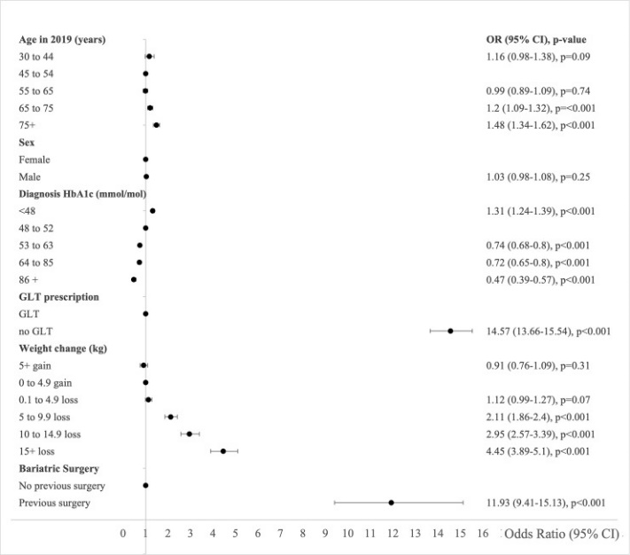
CODE: CAF 18/12
RESEARCH PROJECT BRIEFING
WHAT DID THE STUDY INVOLVE?
This thesis used three different research methods. For the first stage, I conducted a systematic search to describe the variety of remission definitions in scientific literature. For the second stage, I reviewed a register of everyone with diabetes in Scotland to estimate how common remission was (defining remission as blood sugar levels below the diabetes range without the use of glucose lowering drugs). For the final stage, I interviewed PCPs to explore how they understood and defined remission of type 2 diabetes, and how this influenced their approach to care of people in remission or who wish to try to achieve remission. At the outset of the project, I met with the Lothian Diabetes Representative Group to receive their input on my planned project as well as looking at publications that reflected the view of people with type 2 diabetes such as the James Lind Alliance
WHAT WERE THE RESULTS AND WHAT DO THEY MEAN?
The variety of type 2 diabetes remission definitions in the recent research literature highlights a fundamental problem for remission research. This systematic review was the first (to my knowledge) to estimate the variety in remission definitions. Since publication in 2020, it has been cited 20 time including three consensus statements.
The quantitative analysis was the first study to estimate how common remission of type 2 diabetes was in Scotland. We found that 4.8% of people with type 2 diabetes in the study population were in remission. This has been cited 7 time since publication in 2021. Compared to people who did not achieve remission, people in remission tended to: be older; have a lower blood sugar reading at diagnosis; have never taken any glucose-lowering drugs; have lost weight since diagnosis; and have had weight-loss surgery. Sone people may have been in remission due to unintentional weight loss from severe disease or because they were terminally ill.
Defining or recording remission in medical notes did not appear to be a priority for PCPs, as people in remission had exactly the same follow-up as people who were not in remission. For example, they still received an annual diabetes review appointment. However, remission appeared to have nevertheless legitimised a focus on lifestyle or had prompted them to think about type 2 diabetes in a different way.
Remission of type 2 diabetes (bottom axis) is more likely the further to the right the marker is.
Remission of type 2 diabetes was more likely when people: were older; had a lower blood sugar reading at diagnosis; had never taken any glucose-lowering drugs; had lost weight since diagnosis; and had received weight-loss surgery

Slide 3

CODE:CAF: 18/12
RESEARCH PROJECT BRIEFING
WHAT IMPACT COULD THE FINDINGS HAVE?
•This research emphasises the importance of choosing and consistently using the same definition of remission in all clinical guidance. This will make it less confusing for PCPs to diagnose remission. It will also make it easier to do further work on the long-term health outcomes of people in remission if their remission is defined in the same way.
•There are a substantial number of people currently in remission. The needs of these people should be explored so they receive specific support to sustain remission and/or weight loss long-term.
•The number of people in remission suggests that there several routes to remission beyond the very-low calorie diet (Counterweight Plus) formally offered by weight management services. These need to be explored so people who want to pursue remission have more options.
•PCPs may support remission more effectively now that their needs have been described.
HOW WILL THE OUTCOMES BE DISSEMINATED?
I have published two papers in PloS Medicine, a top 10 international General Medicine Journal. The first publications was based on the systematic review (https://pubmed.ncbi.nlm.nih.gov/33112845/) and the second was based on the quantitative findings (https://pubmed.ncbi.nlm.nih.gov/34727107/).
I plan to publish two papers based on the qualitative findings. Chapter 6 of my thesis is a standalone chapter that proposes a potential model of care to support people with remission of type 2 diabetes, from referral to follow-up. This is based on the findings from the three components of this thesis as applied to the NHS clinical care system in Scotland. I intend to circulate this chapter to the managed clinical networks for diabetes in Scotland and Diabetes UK. I have also been asked to meet with Diabetes UK to discuss the findings of this thesis.
CONCLUSION
Consistent, unambiguous guidance is needed on defining and coding remission of type 2 diabetes in primary care. This requires consensus on the purpose and value of remission. Pathways are needed to identify and support people who achieve remission through intentional weight loss with different approaches needed for people who meet criteria for remission through unintentional weight loss. The needs of PCPs should be addressed so they can support remission effectively. Exploring the needs and perspectives of people in remission is likely to offer additional insights. Further research is needed to establish the proportions of people that achieve sustained remission of type 2 diabetes following intentional weight loss and whether people in remission have better long-term outcomes than people whose type 2 diabetes is well-controlled with glucose lowering drugs.
RESEARCH TEAM & CONTACT
Dr Mireille Captieux
University of St Andrews, North Haugh, St. Andrews, KY16 9TF
mc450@st-andrews.ac.uk
0131 651 5446
Additional Information
Study completed 31 January 2023

