Slide 1


CODE: COV/LTE/20/08
RESEARCH PROJECT BRIEFING
TITLE – COVID19: Tracking Persistent Symptoms in Scotland (TraPSS)
AIMS
In this project, we addressed the lack of information about Long-COVID within the Scottish context to improve our understanding of its development and consequences. In doing so, we undertook a series of research studies including:
A systematic scoping review of the available literature
A cross-sectional survey of the effects of Long-COVID on people in Scotland
A prospective symptom tracking of individuals following their infection with COVID-19 to determine the natural history of the infection and the rates at which individuals either recover or progress to Long-COVID.
KEY FINDINGS
Long-COVID symptoms are wide-ranging, with over 100 different symptom categories reported.
Fatigue, Post-Exertional Malaise (PEM; fatigue after exertion), and impaired cognitive function are the most common symptoms affecting most people on most days.
Those in deprived areas were more likely to report a greater number of symptoms.
Long-COVID significantly limits families’ work and caring duties, with those with young children most affected.
About two-thirds of people infected with COVID-19 recover in the first 2-3 months. For the remaining third, recovery can take six months and meet the NICE definition of long-COVID.
A smaller proportion still report at least one symptom after nine months. However, the scale of infection means this translates to a large number of individuals.

Slide 2
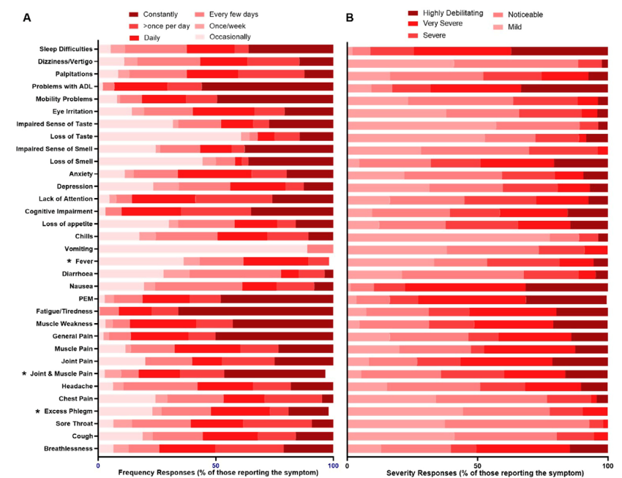
CODE:COV/LTE/20/08
RESEARCH PROJECT BRIEFING
WHAT DID THE STUDY INVOLVE?
This project's first workstream was a scoping review of evidence that met NICE guidelines on persistent symptoms. We assessed over 2,500 research papers with 50 studies in the final synthesis.
In the second workstream of the study, we undertook a survey of people in Scotland with Long-COVID, including questions about participants’ symptoms, based on our review. We also asked about how the condition had affected their day-to-day activities. The questions were reviewed by members of our PPI partners, Long-COVID Scotland, who also helped with recruitment via social media.
The final workstream was a 9-month follow-up of people who had contracted COVID-19 to assess how symptoms develop over time. This included a mobile app to track symptoms which we developed with input and user testing from our PPI partners.
WHAT WERE THE RESULTS AND WHAT DO THEY MEAN?
Our scoping review found more than 100 symptoms of Long-COVID identified in the literature. We also observed significant variations in the reported prevalence, meaning for the same symptom, some studies reported very high prevalence while others reported the prevalence as medium or low. This difference was not explained by the study designs or other aspects of the research methods. As a result, different areas had different experiences of Long-COVID underpinning the importance of better understanding Long-COVID in the Scottish context.
The survey undertaken in workstream two took place between April and August 2022 and included 253 respondents with Long-COVID living in Scotland. The most commonly reported symptoms were breathlessness, cognitive impairment, fatigue, and PEM-like symptoms. The most frequently occurring symptoms were fatigue/tiredness, problems with activities of daily living, general pain, mobility problems, and PEM. While PEM and activities of daily living (ADL) problems were also amongst the most debilitating symptoms, nausea and sleep difficulties were also considered highly debilitating when they occurred. Those from more deprived areas were significantly more likely to report more symptoms and particularly cough, general pain/discomfort, and muscle weakness, as well as more severe breathlessness and dizziness.
Heat Map of Symptom Load
The survey asked people about their Long-COVID symptoms. This included asking how often they experienced specific symptoms (left-hand figure) and how severe the symptoms were when they did experience them (right-hand figure).

Slide 3
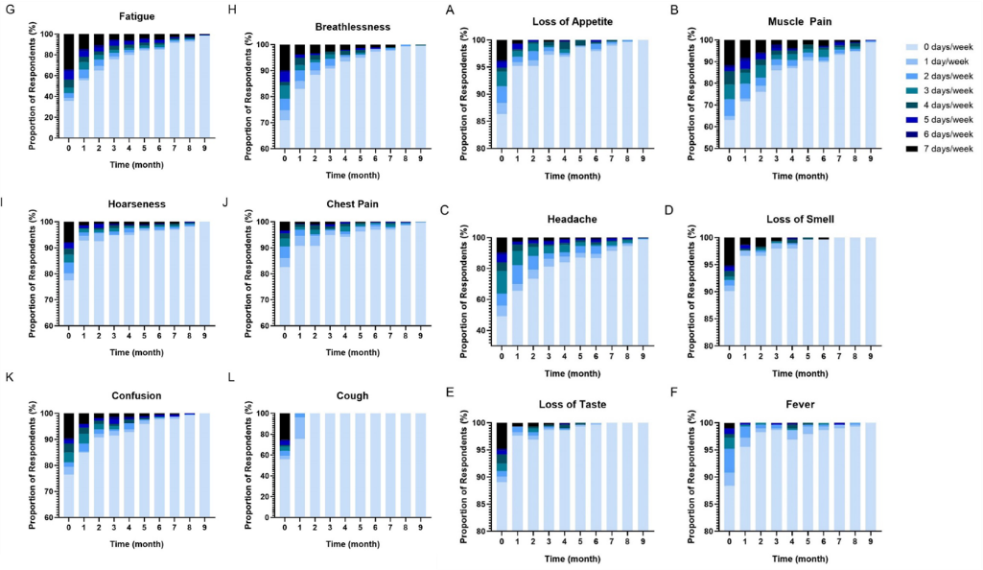
CODE:COV/LTE/20/08
RESEARCH PROJECT BRIEFING
WHAT WERE THE RESULTS AND WHAT DO THEY MEAN?
In Scotland, both males and females were equally affected in their ability to work, with around 50% of both males and females reporting severe limitations. A similar picture emerged regarding Long-COVID and its impact on students' ability to study. Those caring for young children reported the most impact, on caring duties with over three-quarters reporting severe or moderate impact. For those caring for elderly relatives, females were more severely impacted, but about half of both males and females reported their caring ability was severely or moderately impacted.
In the final workstream, we recruited 287 people within four weeks of infection with COVID-19. We provided all of the participants with a mobile app to track their symptoms over the following nine months. The most important finding of the study is that recovery from COVID-19 infection is relatively slow in comparison to other viral infections, which generally resolve within 28 days. Our data demonstrates that most people recover within three months, but for those who do not recover in that time, there is an even more prolonged period of recovery. Many participants reported at least one symptom for eight or nine months, and a smaller proportion still had at least one symptom at the end of the follow-up. We found muscle pain and fatigue were the most persistent symptoms, and women reported more severe fatigue than men, and their fatigue recovered more slowly over time. Despite this, statistical modelling demonstrated that for our data, time was the only important variable to predict recovery, with other factors, such as age or gender, having no effect.
This work is the most detailed analysis of the natural history of COVID-19 infection and symptom progression. It enhances our understanding of the variation in individual responses to better guide clinical decision-making. It also adds to the limited availability of prospective data needed to understand better how people either recover or progress to long-term, persistent symptoms.
Taken together, this project strongly suggests that any rise in COVID-19 infections (e.g. a winter outbreak or new variant), allied to the slow recovery rates, will result in a further surge in those managing debilitating and long-term symptoms lasting several months. Moreover, from workstreams 1 and 2, we also know it is likely that the range of symptoms will be extremely varied, and in addition to poor health, there will likely be severe limitations on individuals’ ability to work, study, and care for their dependents.
Change in Symptoms Each Month
Every month we asked how often people experienced symptoms of COVID-19 infection. For most symptoms, most people recover in the first 1-3 months. However, for some symptoms, recovery is much slower.

Slide 4

CODE:COV/LTE/20/08
RESEARCH PROJECT BRIEFING
WHAT IMPACT COULD THE FINDINGS HAVE?
Our review has already informed the treatment and management of people with persistent symptoms and has been cited over 70 times in key documents.
More broadly, the project has provided the most detailed information yet on the effects of Long-COVID on health, work, and caring duties and on the recovery from the initial infection.
This detail can help policymakers and health planning to better assess the likely consequences of a new surge in COVID-19 or other outbreaks.
These findings will help inform policy regarding the health, social needs, and recovery of those with persistent symptoms.
HOW WILL THE OUTCOMES BE DISSEMINATED?
The results of this project have been disseminated in a variety of ways. The resulting data has produced four peer-reviewed papers directly related to the project aims and two more substantially related. Our group has presented this work at academic, governmental, and public meetings including online and free lectures on COVID. The results of the final longitudinal study will also be presented to clinicians and policymakers.
Future work will apply these findings to other conditions with severe but variable symptom loads. We are also working on similar symptom tracking to understand better how Long-COVID is experienced in children and young adolescents.
CONCLUSION
Long-COVID includes a wide variety of often idiosyncratic symptoms. These symptoms severely limit the individual's health and well-being and their ability to work, study and care for others. Recovery from a COVID-19 infection is slower than other viral infections, with some reporting symptoms up to and beyond nine months after the initial infection. While the proportion of people reporting symptoms at nine months is relatively low, the scale of COVID-19 infections means that this will translate into a large number of individuals who are likely to have chronic health needs. In addition, the slow rate of recovery, allied to the broader health and social consequences, means that it is essential for health policy and planning to consider and plan for, the consequences of any future outbreak.
RESEARCH TEAM & CONTACT
Prof. Nick Sculthorpe
Dr Lawrence Hayes
Dr Joanne Ingram
University of the West of Scotland
Stephenson Place Hamilton International Technology Park Blantyre, Glasgow G72 0LH.
nicholas.sculthorpe@uws.ac.uk
01698 283100
Additional Information
E.g.: Date the project was completed and the amount of funding received

