Slide 1
NHS Scotland Innovation Fellowship Scheme
Information Session
15th August 2023
14:30-15:30

Slide 2
Overview
Innovation Landscape & Vision – Professor David Lowe, CSO Innovation Clinical Director
CSO Innovation Academic Fellowship – Professor David Lowe, CSO Innovation Clinical Director
Key Details & Application Process – Suzanne Graham, Programme Lead Innovation Collaboration
Q&A’s – All
Notes:
Remind participants the session is being recorded

Slide 3
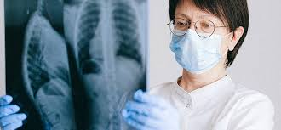
Innovation Fellowship
Aims to strengthen the innovation culture to solve real problems in the NHS and social care, improving the quality, efficiency and sustainability of health and care delivery and supporting NHS Scotland’s Recovery Plan
https://www.cso.scot.nhs.uk/innovationfellowships/

Slide 4
CSO Innovation Actions
Test Beds
Scottish Government Care and Wellbeing Programme
Life Science Industry Leadership Group
UK and Scottish Innovation Agencies
Artificial Intelligence
Priorities for Innovation
Life Science Sector Growth
Investment and Funding
Adoption Strategy for Innovation in NHS and Social Care
Notes:
AF Slide

Slide 5
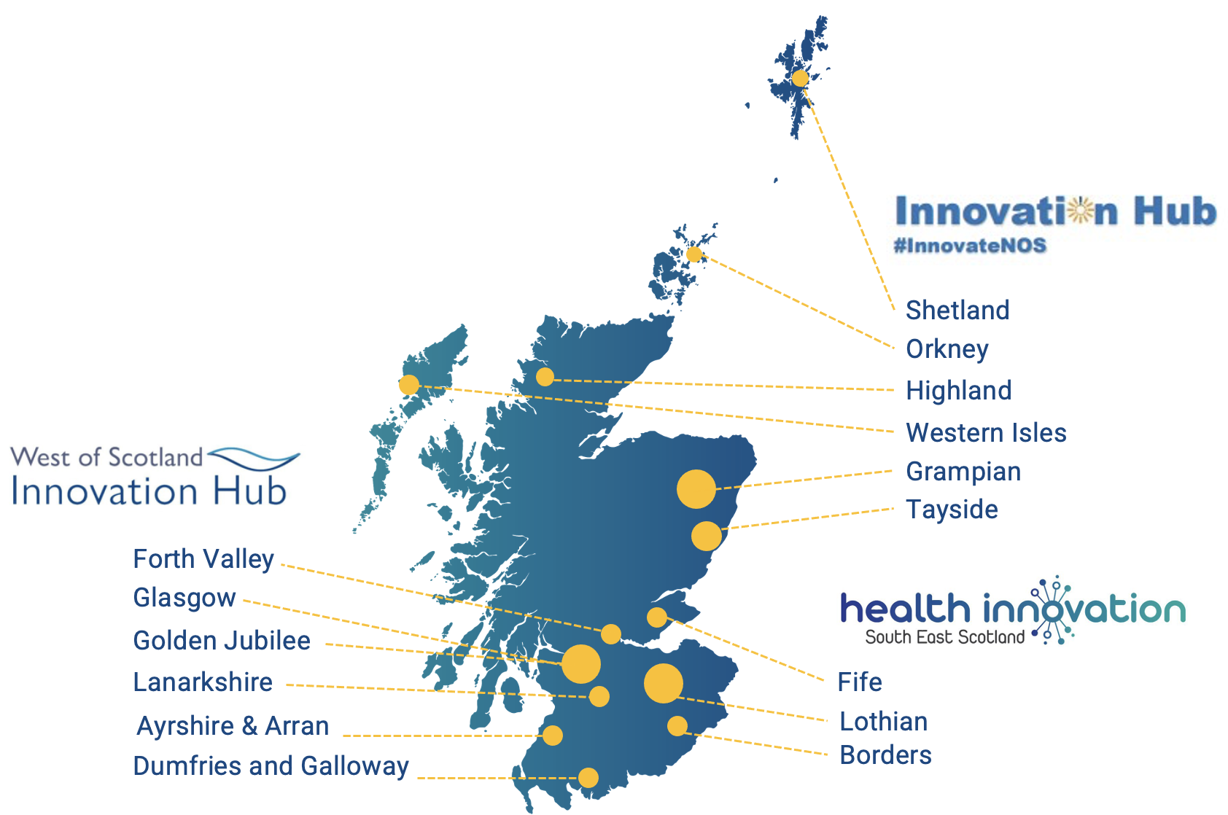
Innovation Hub
Industry
Feasibility
Academia
Fellowship Opportunity
Horizon 3
Pilot
Catalyst Programme
Test of Change
Horizon 2
Horizon 1
Adoption
Evaluation
Development
Investment

Slide 6
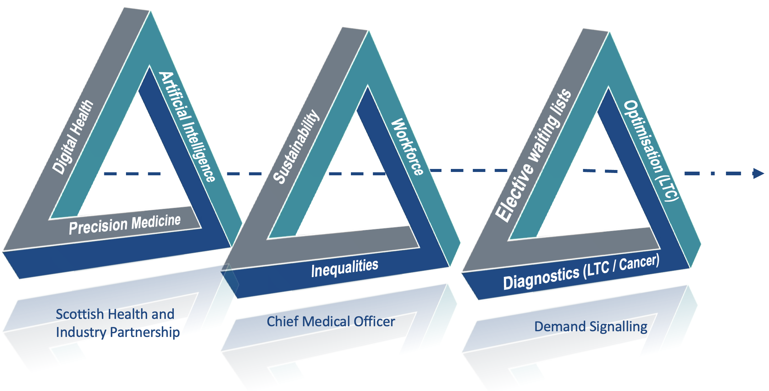
Demand Signaling Priorities

Slide 7
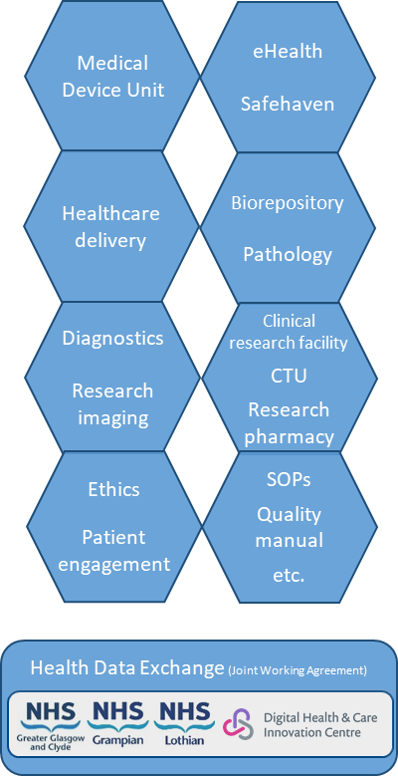
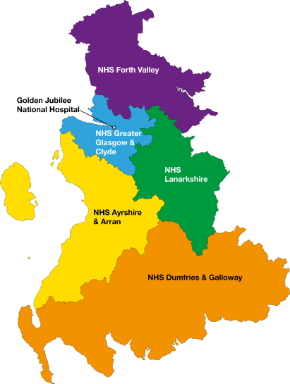
West of Scotland Innovation Hub
NHS SCOTLAND
WEST OF SCOTLAND
OUR HOST BOARD
INNOVATION HUB
WHAT WE DO
OUR TEST BED
Health in Scotland is a devolved power, with policy set by the Scottish Government
Services are delivered through:
14 territorial NHS Boards responsible for the protection and improvement of their population’s health and for the delivery of frontline services (primary care, secondary care, tertiary services)
7 national NHS Boards who support the territorial Boards by providing a range of national services
1 national public health body
We are 6 Health Boards, with 81,000 staff and 2.7m population (50% of Scottish population)
Largest NHS organisation in Scotland and one of the biggest in the UK
35 hospitals, 6,000 beds, including largest hospital in UK
Work with 6 local authorities
Biggest employer in Scotland
Rich innovation ecosystem including iCAIRD and Strength in Places Living Lab partnerships, Health Data Exchange JWA, and typically 1,000 R&I studies/year
2019-20 activity:
510,000 emergencies
215,000 scheduled inpatients
1,185,000 outpatients
7.5 million GP attendances
13,600 babies delivered
24m prescriptions dispensed
One of three NHS Scotland regional test beds funded by SG Chief Scientists Office
Established 2019
In 2021, 57 projects, involving mix of devices, sensors, data, software, Machine Learning / Artificial Intelligence, aided diagnostics and screening
From early stage to late stage innovation, and number scaled to BAU and national
Co-team involving Clinical Leads, Research & Innovation staff, eHealth specialists, wider support services and governance
Facilitate collaborations and access to NHS infrastructure for pre-commercial open innovation
Co-design, co-develop and co-deliver with NHS, academia and industry
Provide leadership, support, regulation support, leverage funding, and access to NHS teams, healthcare settings, data and governance
Build evidence, allow innovators to refine solutions, inform strategy and develop thinking, support routes to scale-up and mainstreaming, and seek preferential access for NHS Scotland to final products
Provide access to NHS test bed infrastructure and support

Slide 8
Our services and support
SCOPING | PROJECT DELIVERY | EVALUATION | SCALE-UP SUPPORT
Develop and co-author grant and funding bids (e.g. SBRI, UKRI) Reference cost model for NHS R&I, eHealth and clinical services resource as we are required to ensure all subsequent innovation project work is cost-recovered Access to clinicians, health and social care settings to explore and scope ideas Early consideration of regulatory, ethics and governance approvals required Exploring current landscape such as devices, systems, service pressures, data, other ongoing projects and initiatives Exploring availability of data, cohorts and linkages | Project management Contracting Governance approvals (including organisational, Information Governance and IT compliance) Ethics approvals Co-design, co-development and co-delivery of solutions Access to eHealth, R&I, data and clinical subject matter experts | Service evaluations Clinical studies (e.g. feasibility, evaluation) Unregulated clinical trials Regulated clinical trials of non-medicinal products (e.g. medical devices such as AI or software which aid clinical decisions) Input to academic publications Advice on optimisation / refining solution Working with specialist partners to undertake Innovative Medical Technology Overviews (IMTO) Medtech briefings Health Economics and Health Technology Assessments (HEHTA) | Knowledge and know-how for all parties Future strategies informed Local adoption / scale-up routes National adoption / scale-up routes Preferential access for NHS Scotland to final products Post-market surveillance Future collaborations Comms and media channels
TEST BED | Medical Devices Unit | Diagnostics & Research Imaging | Safe Haven (data) | Biorepository | Clinical Research Facility | Clinical Trials Unit | Research Pharmacy
 | eHealth, including Health Data Exchange, a secure cloud-based innovation enabling platform which provides a standardised way of managing identity (login) and consented data sharing, integrations with new and existing health and care systems, and hosts industry developed applications based on re-usable components
PARTNERS | Our core innovation programmes and partnerships including WoS Regional Test Bed, iCAIRD, Living Laboratory, Health Data Exchange Joint working agreements and MoUs including with Astra Zeneca, GSK, Digital Health & Care Innovation Centre Academic including most Scottish Universities, and in particular University of Glasgow Scottish innovation ecosystem including peer Test Beds in East and North Scotland, InnoScot, HealthCare Improvement Scotland (SHTG), Centre for Sustainable Delivery, Scottish Health and Industry Partnership, Chief Scientists Office, NES Digital, NSS, SAS

Slide 9
Engage & Scope
Clinical Engagement
Mapping clinical process
User Feedback
Literature Review
Use Specification
Pilot & Feasibility
Access to data, build models, curated benchmark data
Near-clinical simulation platform
Market Validation
NHS Adoption Support
Procurement advice
Deployment platforms
Define technical architecture
Initiate & Co-Design
Product and roadmap definition
Patient & Public Involvement
Integrated Civic Engagement
Partner, investor and funds matching
Clinical Validation
Clinical Evaluation plan
Study Design
Health Technology Assessment Evidence Reporting
Scale
Post-implementation surveillance advice, monitoring and feedback
National scale-out orchestration
Link to export and growth pathways
Investor and funds matching
Technical Readiness TRL 3-6
Technical Readiness TRL 6-9
Business / Service Readiness > 8
Entrepreneurship
Funding / Equity
Market Access

Slide 10
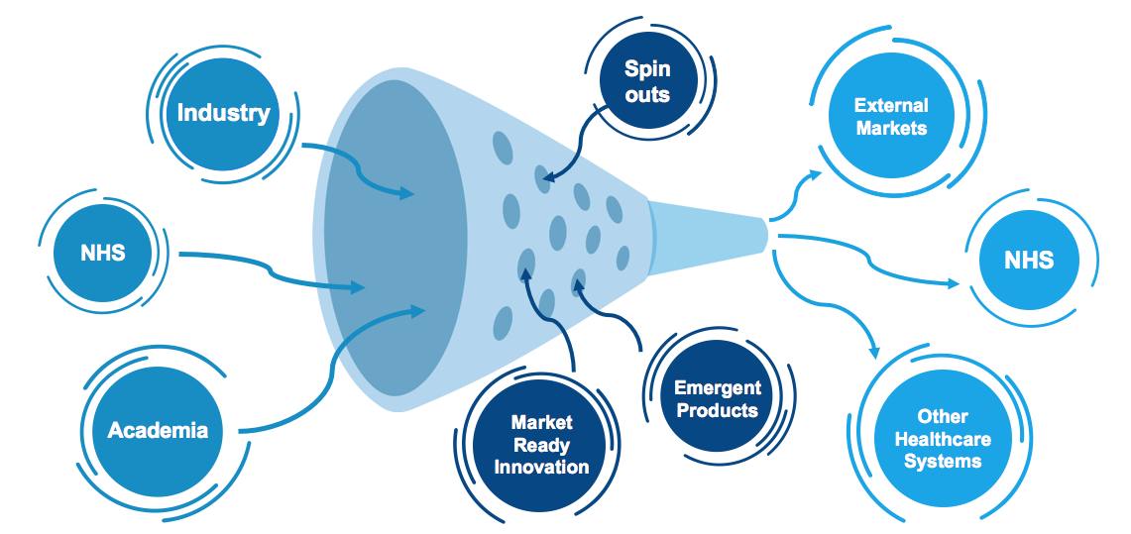
Open Innovation
Additional text space / quotes….

Slide 11
Realising Value
Notes:
Support ministerial priorities
System to support
Regulatory
Evidence / ROI /evaluation
Techncial / business services
Pipeline and catalyst
Ready for implementation putlish the criteria
Demonstrate pathway
Early vs late
Support adoption

Slide 13
Key details
Opportunity for clinicians early in their career to undertake a higher degree (MD/PhD).
100% funded, including university fees (although limits around salaries payable as the scheme is aimed at early career).
Up to 3 places available, subject to the suitability of the candidates.
Open to clinical NHS Scotland staff.
Example projects, with a network of Innovation Leads, will be available.
Applicants will develop their proposal in conjunction with the Innovation Leads and regional Innovation Hubs, utilising existing innovation infrastructure.

Slide 14
Eligibility
Health Professionals (e.g. NMAHPS, Healthcare Scientists, Pharmacists, Psychologists)
Applicants must be employed in a Health Board in Scotland in a clinical role (direct care) or a role that supports clinical practice (teaching, facilitation, leadership, management)
Salary requests for this category of applicant can be no higher than Band 7.
Medical and Dental Specialists
Applicants are required to hold a Scottish National Training Number (NTN).
Demonstrate satisfactory progression through training, such as an outcome 1 at most recent ARCP.
The time out of training for research (OOPR) will need to be agreed by the postgraduate dean before application.

Slide 15
Timelines
Applications close midday on Thursday 12th October 2023.
Interviews will take place on 18th or 19th January 2024.
Notification of outcome within a week following the last interview.
Successful applicants can start from 1 April - 1 October 2024. Doctors in training must start in August 2024.

Slide 16
Application
Guidance and application form on CSO website.
Applicants will develop their proposal with the Regional Innovation Hubs and Innovation Leads.
In addition to the Innovation Lead, applicants must identify a supervisor from their chosen university.
Word limit for all questions.
The applicant must obtain the necessary support from
Innovation Hub/Innovation Lead Supervisor
University Supervisor
Host Board Head of Innovation
Clinical Supervisor (current or most recent)
Postgraduate Dean (if applicable)

Slide 17
Innovation Themes
1. Innovation in Cancer Pathways
2. Innovation for Long Term Conditions Optimisation
3. Innovation for Long Term Conditions Diagnostics

Slide 18
Example Projects
Health Innovation South East Scotland
Digital Transformation and Artificial Intelligence in the Lung Cancer Diagnostic Pathway
Development, deployment and testing of artificial intelligence-driven dashboard to manage COPD in patients with multimorbidity
Evaluating innovative approaches to proactive care for older people living with frailty
North of Scotland Innovation Hub
Digital Transformation in Colonoscopy: Enhancing Assessment, Ergonomics, and Efficiency.
West of Scotland Innovation Hub
Implementing and evaluating wearable and AI-based assistive technologies: Improving outcomes in cardiorespiratory long term condition management
Diagnostic technologies for evaluation of Acute Ischaemic Stroke due to Large Vessel Occlusion
Implementing and evaluating Closer-to-Home Ophthalmic Diagnostics: Improving outcomes and reducing carbon in ophthalmology for long-term condition monitoring and management

Slide 19
Assessment
Applications will be assessed using the following criteria:
The experience and relevant expertise of the applicant.
The quality of the proposed research and innovation project.
The quality of the supervision arrangements.
Shortlisted applicants will be invited to attend an online interview on the 18th or 19th of January 2024.

Slide 20
Key Contacts
Regional Innovation Hub Clinical Leads and Contact Details
South East:
Professor Tim Walsh (timothy.walsh@ed.ac.uk)
Health Innovation South East Scotland (innovations@nhslothian.scot.nhs.uk)
North:
Professor Colin Fleming (colin.fleming@nhs.scot) and Dr Andrew Keen (andrew.keen@nhs.scot)
North of Scotland Innovation Hub (gram.nosinnovationtestbed@nhs.scot)
West:
Dr Neil Patel (Neil.Patel@ggc.scot.nhs.uk)
West of Scotland Innovation Hub (innovation@ggc.scot.nhs.uk)
Chief Scientist Office
InnovationFellowship@gov.scot

Slide 21
Questions

