Slide 1
CODE: TCS/16/31
RESEARCH PROJECT BRIEFING
Vascular Effects of VEGFi Anti-Cancer Drugs
Major advances in cancer treatment have been made over recent years. Vascular endothelial growth factor inhibitor (VEGFi) anti-cancer drugs represent one of the new classes of cancer therapy. These drugs improve cancer outcomes but many patients develop high blood pressure (BP) and there is an increased risk of of heart attacks and strokes caused by blood clots. The causes may include changes in blood vessel function by altering levels of the blood vessel constricting hormone, endothelin-1 (ET-1), and the blood clot dissolving factor, tissue plasminogen activator (tPA). We assessed the immediate effects of bevacizumab (a VEGFi drug) upon blood vessels (arteries) in healthy participants. We gave the drug directly into the artery of the forearm so that we could assess the effects in that region only without giving doses that would be big enough to cause any effect in the rest of the body. We assessed the immediate effects of bevacizumab on resting blood flow, stimulated blood flow responses to bradykinin (a drug that increases blood flow and allows sensitive measurement of blood vessel function), ET-1 levels and tPA levels. The studies were performed in the presence and absence of the ET-1 blocker drug, BQ-123. We are interested in whether these drugs may prevent VEGFi’s potentially harmful blood vessel effects in patients with cancer.
AIMS
KEY FINDINGS
In the very early phase:
Bevacizumab does not alter resting or stimulated blood flow, nor levels of the hormones ET-1 or tPA.
The ET-1 blocker drug BQ-123 does not alter stimulated blood flow in response to bradykinin (a hormone that causes blood vessel relaxation) when bevacizumab is present.
Our findings suggest vascular changes causing high BP or blood clots in the immediate period after treatment with VEGFi anti-cancer drugs are not caused by changes in ET-1 or tPA.
The role of ET-1 and tPA in provoking cardiovascular problems in patients who are treated with long-term VEGFi drugs should be explored further.

Slide 2
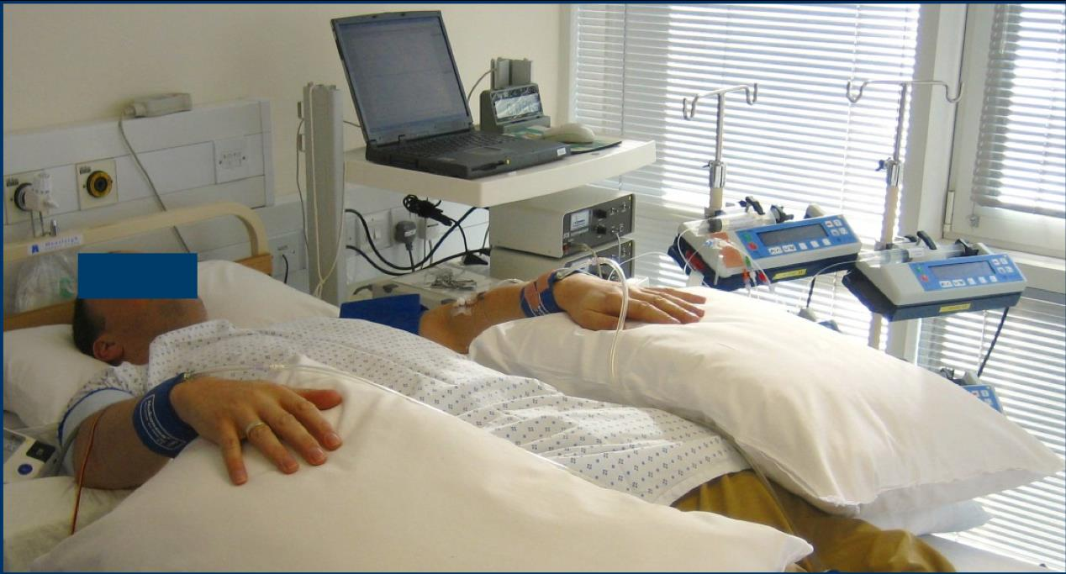
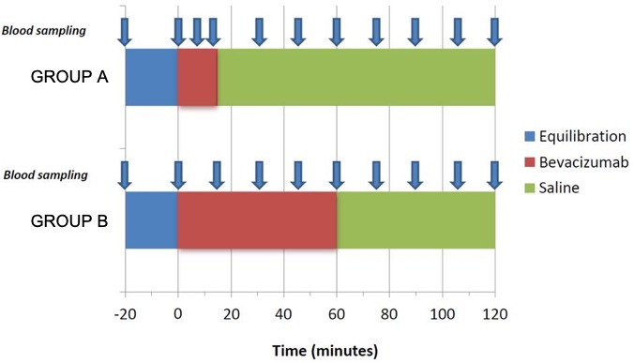
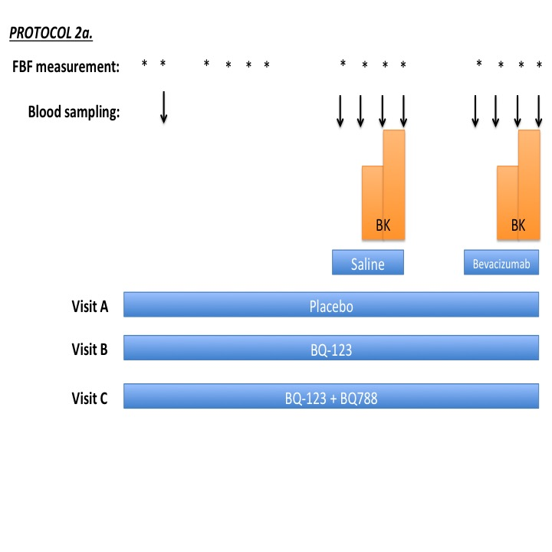
CODE: TCS/16/31
RESEARCH PROJECT BRIEFING
WHAT DID THE STUDY INVOLVE?
We performed forearm plethysmography studies in 38 healthy male volunteers. We did not include females to avoid potential risks from VEGFi in pregnancy. Plethysmography involves lying on a bed with cuffs on both arms to measure blood flow, a small needle in the artery of one arm and small plastic tubes in the veins in each arm. It is highly accurate and allows results to be drawn from small numbers of participants. Drugs are delivered directly into the arterial circulation at locally active doses 10 – 100 times lower than would be required to exert effects in the rest of the body. Forearm blood flow (FBF) measurement and venous blood samples are taken at intervals throughout.
Forearm plethysmography set-up
Protocol 1: We assessed the effects of bevacizumab on resting blood flow and ET-1 levels, at doses of 36, 72 and 144 µg/dL for 15 minutes (Group A) and 36 µg/dL for 60 minutes (Group B).
Protocol 1. Schedule of infusions, measurements and blood sampling
Protocol 2: We assessed the effects of bevacizumab 144 µg/dL for 15 minutes on stimulated blood flow and tPA release in response to bradykinin, in the presence and absence of an endothelin blocker (BQ-123).
Protocol 2. Schedule of infusions, measurements and blood sampling

Slide 3
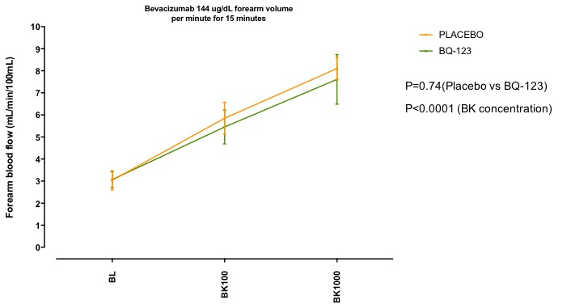
CODE: TCS/16/31
RESEARCH PROJECT BRIEFING
WHAT WERE THE RESULTS AND WHAT DO THEY MEAN?
PROTOCOL 1: RESTING BLOOD FLOW AND ET-1 LEVELS
Resting blood flow and ET-1 levels did not change during or after bevacizumab at all studied doses and durations of administration.
RESTING
BLOOD FLOW
ET-1
LEVELS
PROTOCOL 2: STIMULATED BLOOD FLOW AND tPA RELEASE
Text to explain any Graphic
Bevacizumab did not alter bradykinin-induced stimulated blood flow or tPA release.
STIMULATED
BLOOD FLOW
PROTOCOL 2: EFFECTS OF ENDOTHELIN RECEPTOR BLOCKER
STIMULATED
BLOOD FLOW
The endothelin receptor blocker BQ-123 did not alter bradykinin-induced stimulated blood flow when bevacizumab was present.

Slide 4
CODE: TCS/16/31
RESEARCH PROJECT BRIEFING
WHAT IMPACT COULD THE FINDINGS HAVE?
Our findings provide important evidence that VEGFi drugs do not cause an immediate blood vessel constricting effect and do not cause an immediate alteration in the release of ET-1 and tPA hormones.
Our study does not rule out these factors in causing cardiovascular problems from VEGFi in the longer term and will help design future studies to prevent cardiovascular disease from VEGFi .
Our findings will inform trials of strategies to protect the cardiovascular health of patients receiving VEGFi. This will allow the doses and benefits of anti-cancer therapies to be maximised while minimising cardiovascular side effects.
HOW WILL THE OUTCOMES BE DISSEMINATED?
Presentation at the British Pharmacological Society Annual Meeting in December 2018.
Manuscript in preparation for submission to high impact, peer-reviewed journal in 2019.
Patient and staff engagement events at the Beatson West of Scotland Cancer Centre.
CONCLUSION
In the immediate period, bevacizumab does not affect blood vessel relaxation, nor levels of the hormone ET-1 or the blood clot dissolving factor t-PA.
Vascular changes causing high BP and blood clots in the early period after VEGFi anti-cancer drugs do not appear to be driven by these factors.
Research into the vascular changes causing high BP in the early period after VEGFi drugs should investigate other possible mechanisms and make assessments at a later time following drug administration.
The role of ET-1 in the development of high BP and other cardiovascular disease in patients undergoing long-term treatment with VEGFi drugs should be explored further. Although we only examined responses in men, there is no reason to expect different results in women.
RESEARCH TEAM & CONTACT
Dr Alan C Cameron, Dr Ninian N Lang, Prof Rhian M Touyz
Institute of Cardiovascular and Medical Sciences, 126 University Place, University of Glasgow, G12 8TA
ninian.lang@glasgow.ac.uk
+44 (0)141 330 6937
Additional Information
The project was completed on 31/10/18 and received £88,732 from the Chief Scientist Office.

